Slide 1
EEE Lecture-9
CHAPTER 8: METHODS OF ANALYSIS AND SELECTED TOPICS (DC)
*
‹#›

Slide 2
Objectives
Become familiar with the terminal characteristics of a current source
Determine how to solve for the voltages and currents of a network using current sources and/or current sources and voltage sources.
Be able to apply branch-current analysis and mesh analysis to find the currents of network with one or more independent paths.
Be able to apply nodal analysis to find all the terminal voltages of any series-parallel network with one or more independent sources.
Become familiar with bridge network configurations and how to perform Δ-Y or Y-Δ conversions.

Slide 3
8.1 Introduction
The methods to be introduced in this chapter include:
branch-current analysis,
mesh analysis, and
nodal analysis.
Each can be applied to the same network, although usually one is more appropriate than the other.
A strict set of rules cannot define the “best” method but can be determined only after developing an understanding of the relative advantages of each.

Slide 4
8.2 Current Source
The voltage source was the only source appearing in the circuit analysis so far. This was primarily because voltage sources such as the battery and supply are the most common in our daily lives and in the laboratory environment.
Now let us turn our attention to a second type of source called the current source.
Although current sources are available as laboratory supplies, they appear extensively in the modeling of electronic devices such as the transistor.

Slide 5
8.2 Duality of Voltage & Current Source
The current source is often referred to as the dual of the voltage source.
Just as a battery provides a fixed voltage to a network, a current source establishes a fixed current in the branch where it is located.
Further, the current through a battery is a function of the network to which it is applied, just as the voltage across a current source is a function of the connected network.

Slide 6
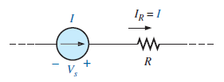
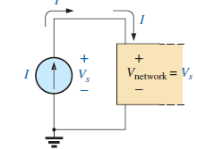
8.2 Symbol of Current Source
The symbol for a current source appears below. The arrow indicates the direction in which it is supplying current to the branch where it is located. The result is a current equal to the source current through the series resistor.
In Fig. 8.1(b), we find that the voltage across a current source is determined by the polarity of the voltage drop caused by the current source.
For single-source networks, it always has the polarity of Fig. 8.1(b).
In general, therefore
a current source determines the direction and magnitude of the current in the branch where it is located.
Furthermore
the magnitude and the polarity of the voltage across a current source are each a function of the network to which the voltage is applied.

Slide 7
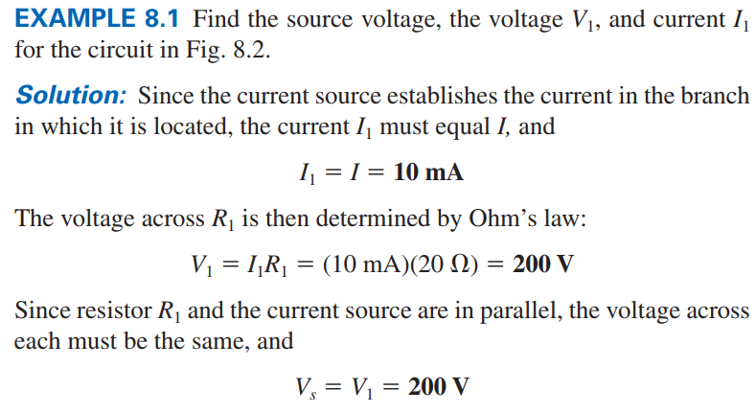
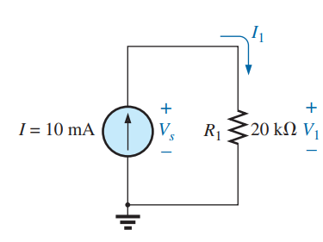

Slide 8
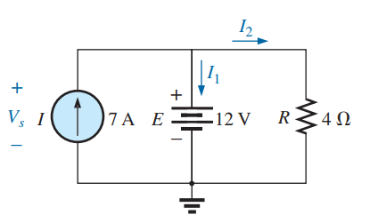
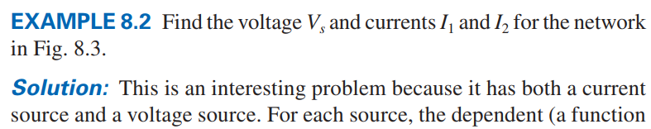
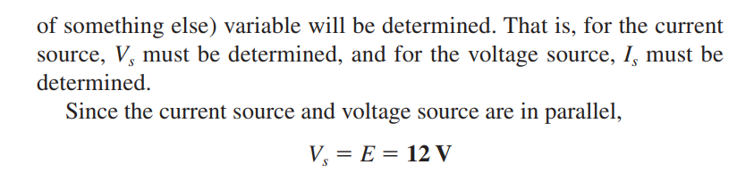

Slide 9
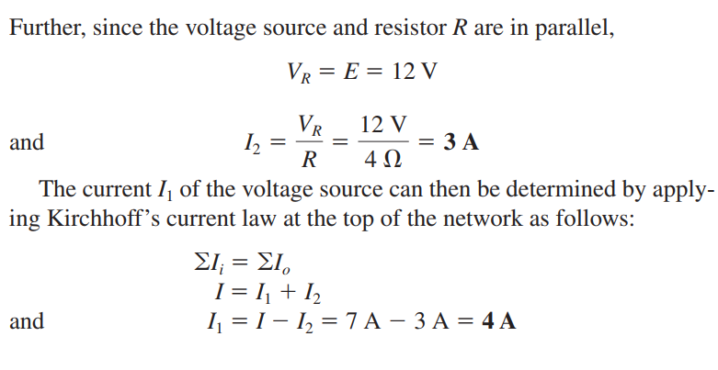

Slide 10
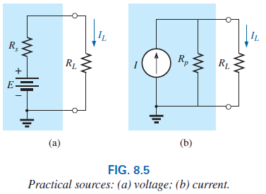
8.3 Source Conversion
The current source appearing in the previous section is called an ideal source due to the absence of any internal resistance.
In reality, all sources—whether they are voltage or current—have some internal resistance in the relative positions.

Slide 11
8.3 Source Conversion
For the voltage source, if Rs = 0 Ω or if it is so small compared to any series resistor that it can be ignored, then we have an “ideal” voltage source for all practical purposes.
For the current source, since the resistor R_{P} is in parallel, if Rp = ∞ Ω or if it is large enough compared to other parallel elements that it can be ignored, then we have an “ideal” current source.

Slide 12
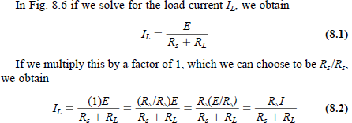
8.3 Source Conversion
We want the equivalence to ensure that the applied load will receive the same current, voltage, and power from each source and in effect not know, or care, which source is present.

Slide 13
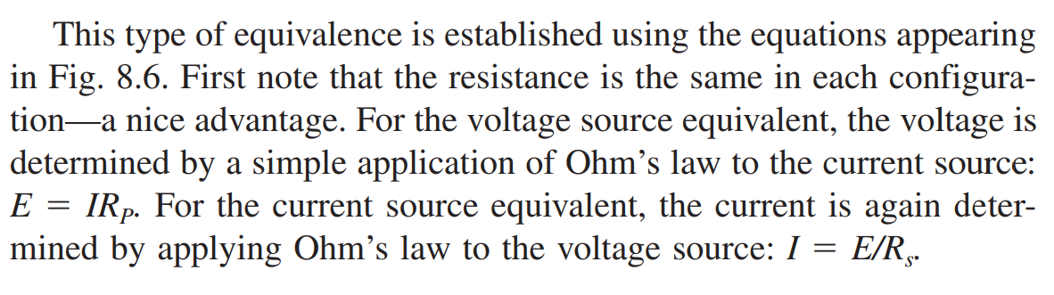
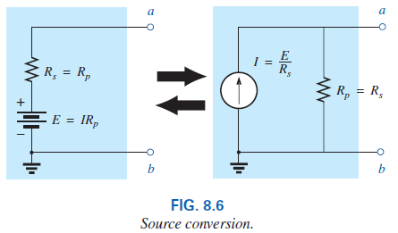
8.3 Source Conversion

Slide 14
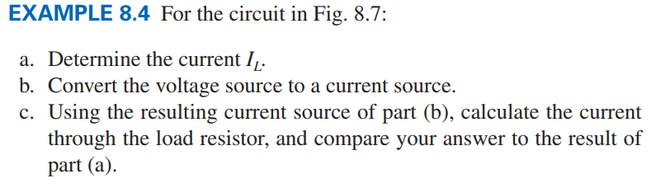
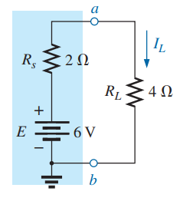
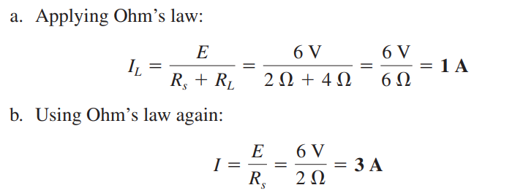
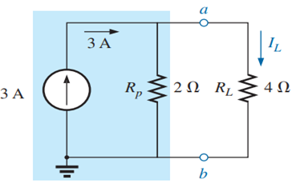
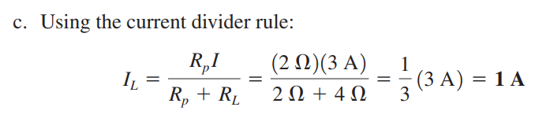

Slide 15
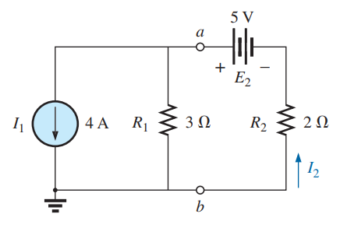
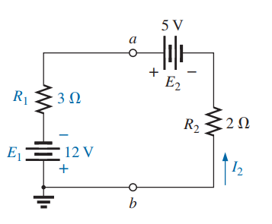
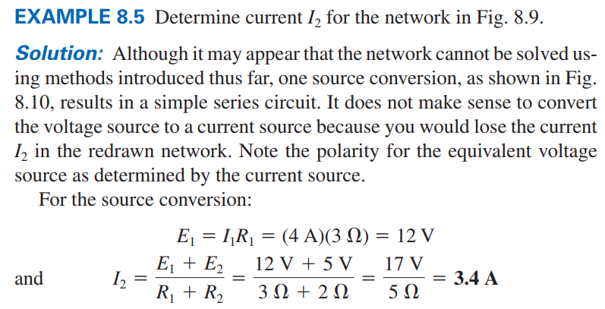

Slide 16
8.4 Current Sources in Parallel
We found that voltage sources of different terminal voltages cannot be placed in parallel because of a violation of Kirchhoff’s voltage law.
Similarly, current sources of different values cannot be placed in series due to a violation of Kirchhoff’s current law.
However, current sources can be placed in parallel just as voltage sources can be placed in series.
In general, two or more current sources in parallel can be replaced by a single current source having a magnitude determined by the difference of the sum of the currents in one direction and the sum in the opposite direction.

Slide 17
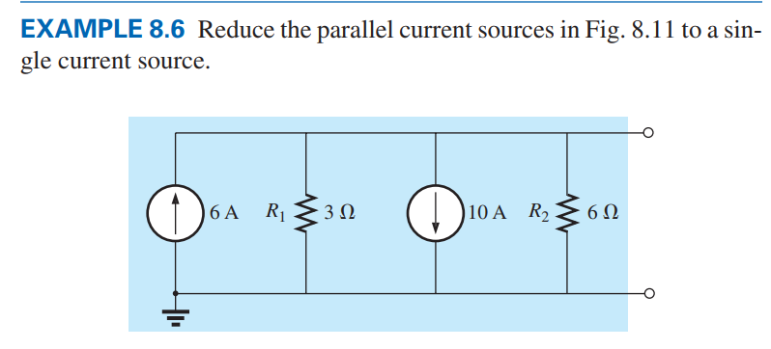
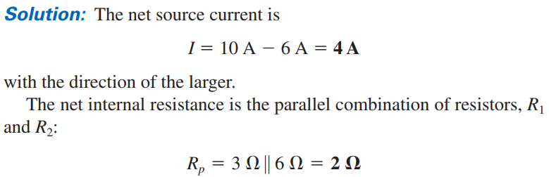
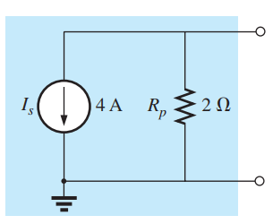

Slide 18
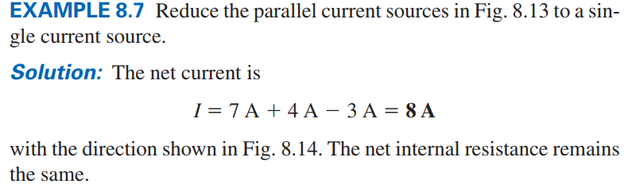
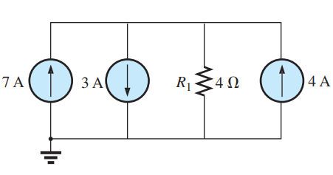
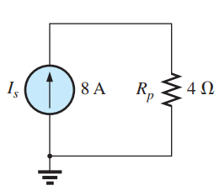

Slide 19
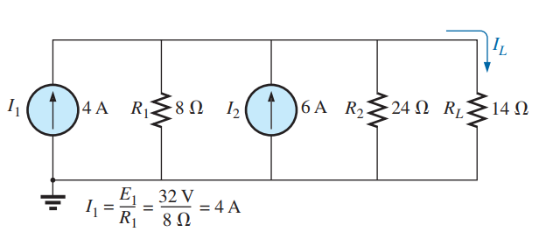
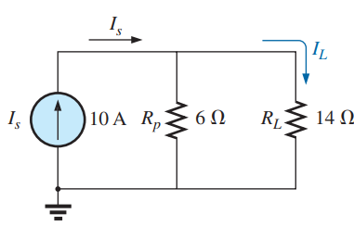
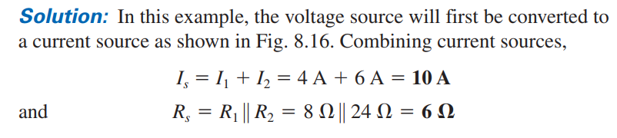
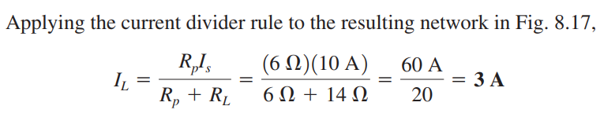

Slide 20
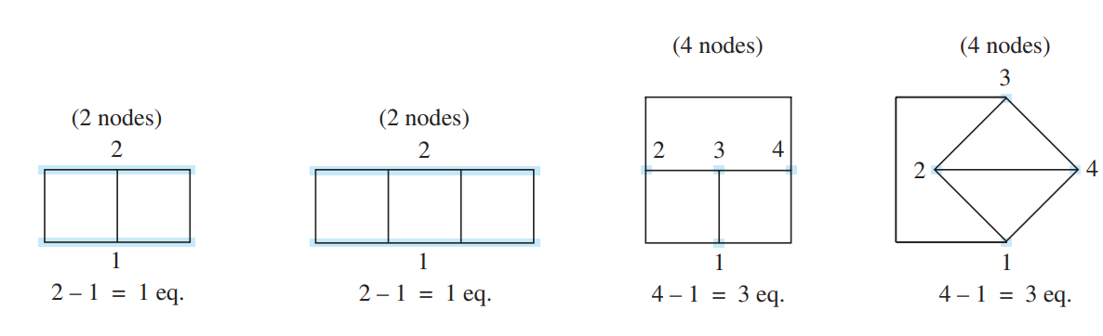
8.6 Branch-Current Analysis
Method for solving networks with two or more sources.
Once the branch-current method is mastered, there is no linear dc network for which a solution cannot be found.
A node is a junction of two or more branches, where a branch is any combination of series elements.
This method will help to calculate the current through each branch of the network, the branch current. Once this is known, all other quantities, such as voltage or power, can be determined.

Slide 21
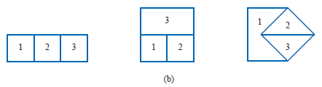


Branch-Current Analysis Procedure
Assign a distinct current of arbitrary direction to each branch of the network.
Indicate the polarities for each resistor as determined by the assumed current direction.
Apply Kirchhoff’s voltage law around each closed, independent loop of the network.
The best way to determine how many times Kirchhoff’s voltage law will have to be applied is to determine the number of “windows” in the network.

Slide 22
8.6 Branch-Current Analysis
4. Apply Kirchhoff’s current law at the minimum number of nodes that will include all the branch currents of the network. The minimum number is one less than the number of independent nodes in the network.
5. Solve the resulting simultaneous linear equations for assumed branch currents.

Slide 23
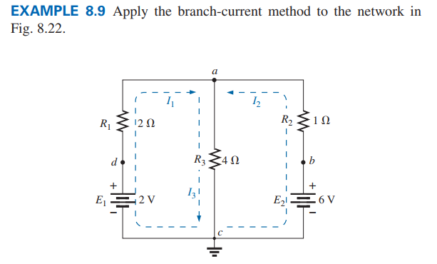
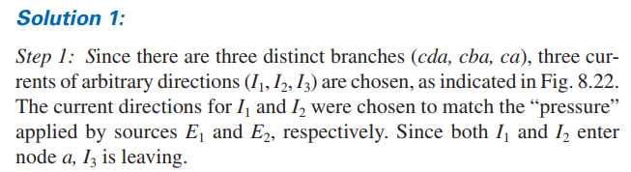

Slide 24

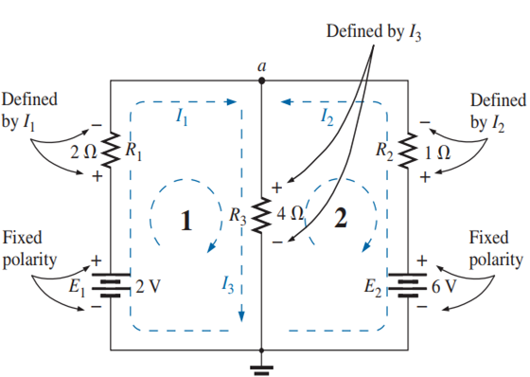
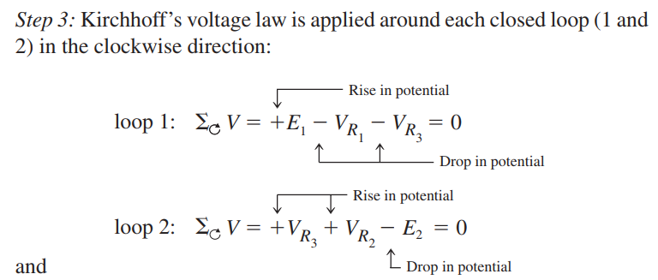

Slide 25
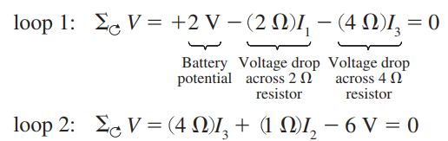
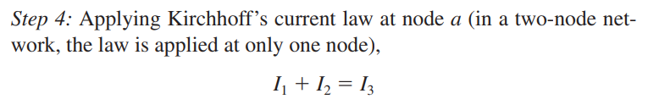

Slide 26
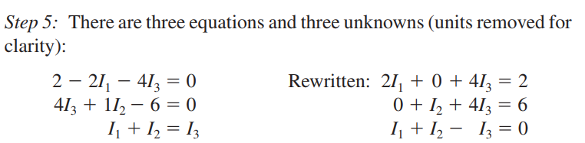
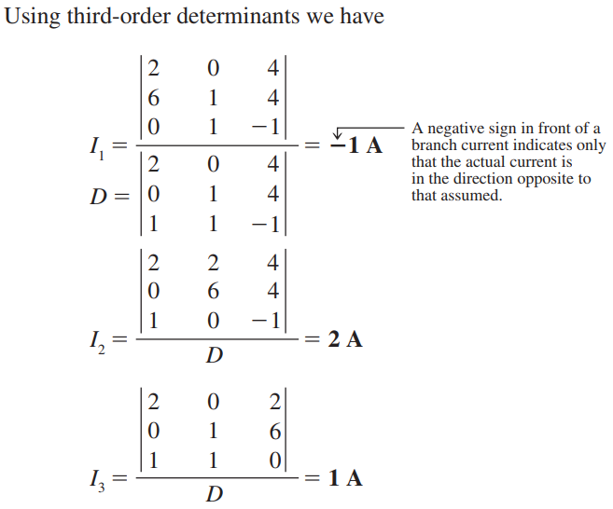

Slide 27
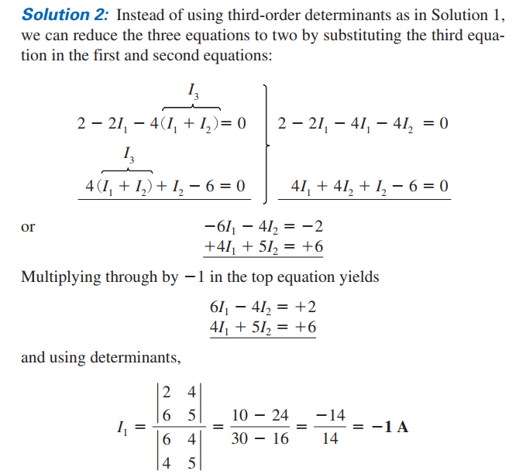
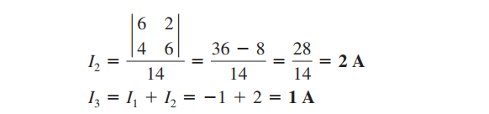

Slide 28
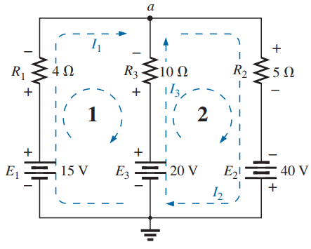
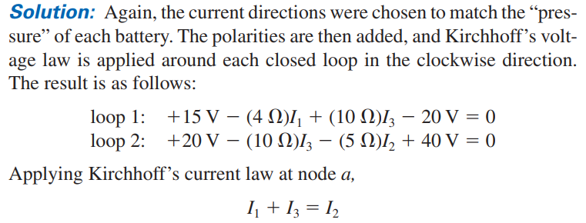

Slide 29
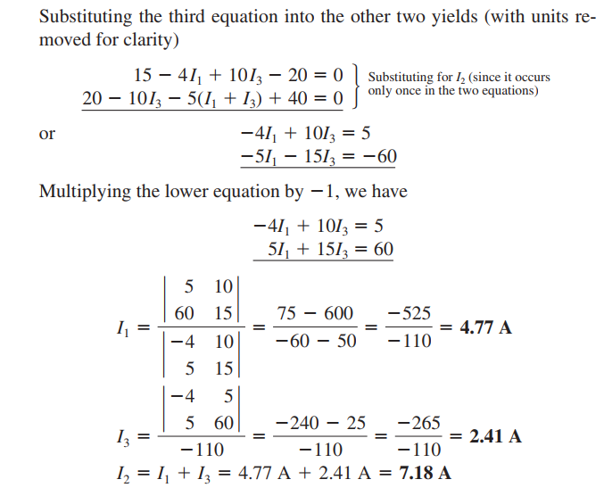

Slide 30
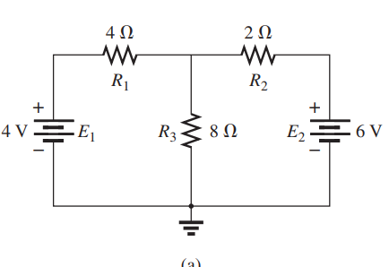

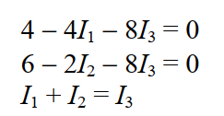
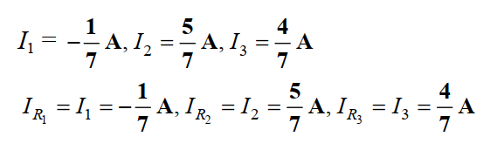

Slide 31
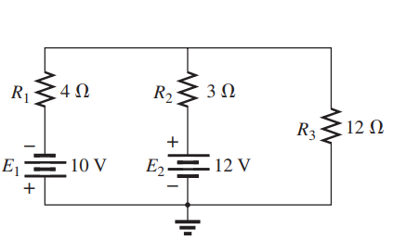

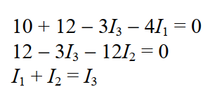


Slide 32
Thank You
*
‹#›

